Slide 1

Hazard Prediction
Predict a transformed count of hazards or pre-existing damages using a dataset of property information.
Brian Chaplin Kaggle Competition July 11, 2015

Slide 2
What’s the challenge?
Newly insured properties receive a home inspection.
These inspections review the condition of key attributes of the property, including things like the foundation, roof, windows and siding.
Predict a transformed count of hazards or pre-existing damages using a dataset of property information.
to more accurately identify high risk homes that require additional examination to confirm their insurability.
Notes:
To ensure that Liberty Mutual’s portfolio of home insurance policies aligns with their business goals, many newly insured properties receive a home inspection. These inspections review the condition of key attributes of the property, including things like the foundation, roof, windows and siding. The results of an inspection help Liberty Mutual determine if the property is one they want to insure.
In this challenge, your task is to predict a transformed count of hazards or pre-existing damages using a dataset of property information. This will enable Liberty Mutual to more accurately identify high risk homes that require additional examination to confirm their insurability.

Slide 3

X: What are the features?
These [home] inspections review the condition of key attributes of the property, including things like the
foundation,
roof,
windows and
siding.
32 features, all appear to be categorical values
16 are numeric but all have 100 or less values
5 are binary character
11 are multinomial character
51,000 observations each in training and test sets

Slide 4
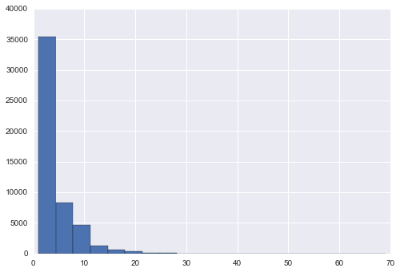
y: What’s the prediction (response)?
Predict a transformed count of hazards or pre-existing damages using a dataset of property information
50 discrete scores, ranging from 1 to 69
Ordinal labels
36% are no hazard, 1, and
75% < 5
rank ordering so focus on just getting them ordered right
99.9% < 30, so concentrate on those

Slide 5

How to make sense of these columns? Is there a direction to these?
No hazard (negative)
A lot of hazard (positive)
Hazard | T1_V8 | T1_V1 | T1_V2 | T2_V1 | T1_V15 | T1_V4
1 | B | 15 | 3 | 36 | A | N
1 | B | 7 | 17 | 64 | A | B
1 | B | 1 | 11 | 26 | N | C
1 | B | 17 | 4 | 71 | A | B
1 | B | 4 | 8 | 64 | A | N
Hazard | T1_V8 | T1_V1 | T1_V2 | T2_V1 | T1_V15 | T1_V4
51 | B | 18 | 20 | 40 | C | C
52 | C | 10 | 15 | 20 | A | N
63 | C | 19 | 7 | 15 | A | N
64 | C | 19 | 13 | 57 | A | W
69 | C | 13 | 20 | 50 | A | N

Slide 6
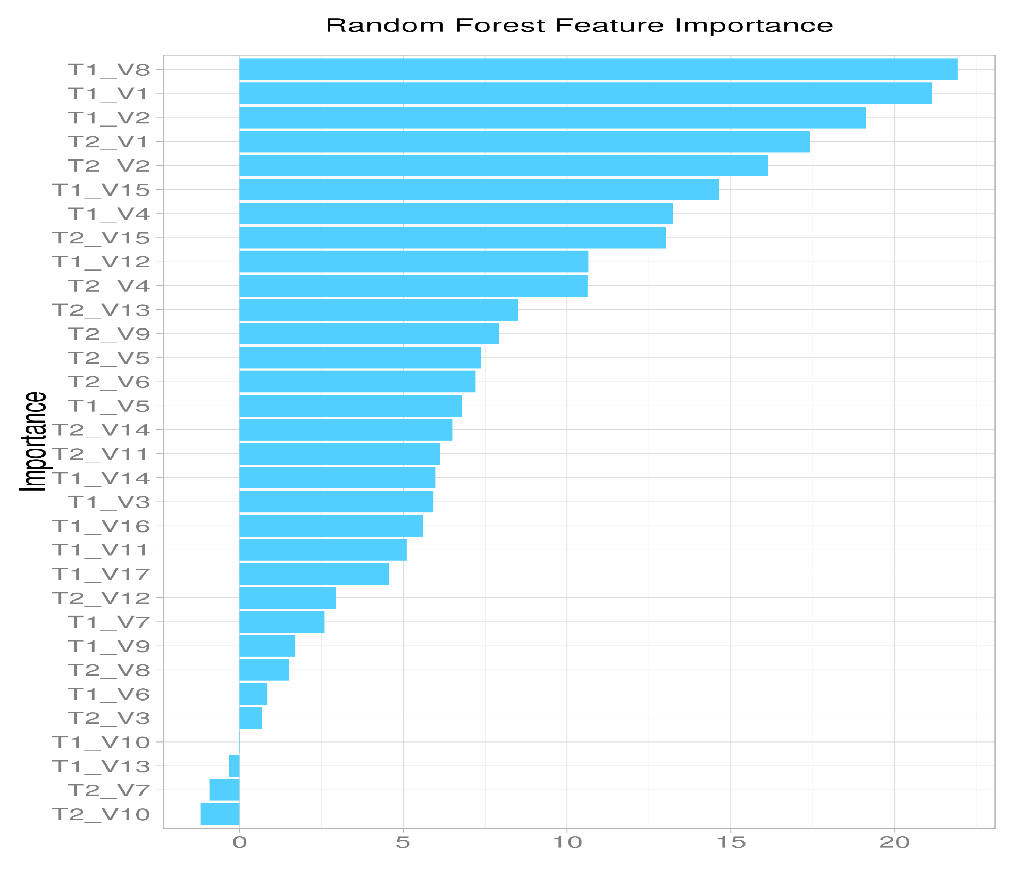

I don’t know the subject. Where do I start?
Run a classification and see which variables are the most important

Slide 7
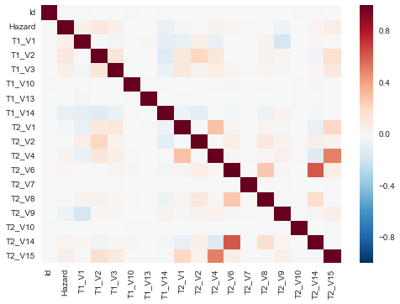
2. Combine collinear features
At least one collinearity among the numeric categories

Slide 8
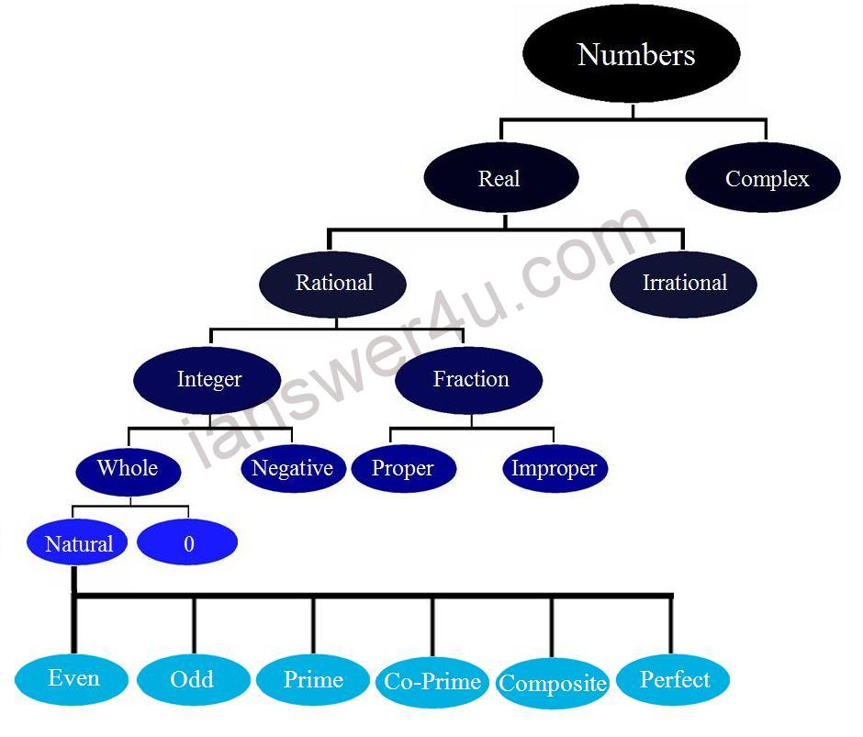
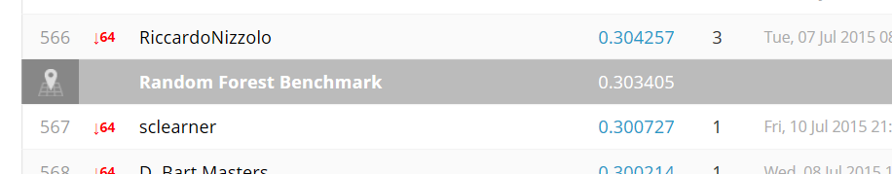
Multiclass classification, which model?
Inherently multiclass:
Naïve Bayes
Linear Discriminant
Decision Trees
Random Forests
Nearest Neighbors
Logistic Regression (multinomial)
Random Forest is the benchmark, so start with that
ensemble.RandomForestRegressor(n_estimators=200, max_depth=9)

Slide 9

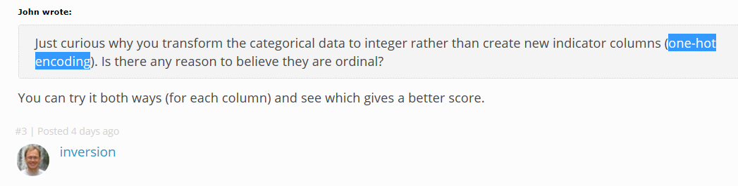
Strategy: encode character variables
Remove all characters and make them numbers?
Make dummy variables?
Use preprocessing.LabelEncoder()?
Use linear discriminant analysis to remove collinear categories?

Slide 10
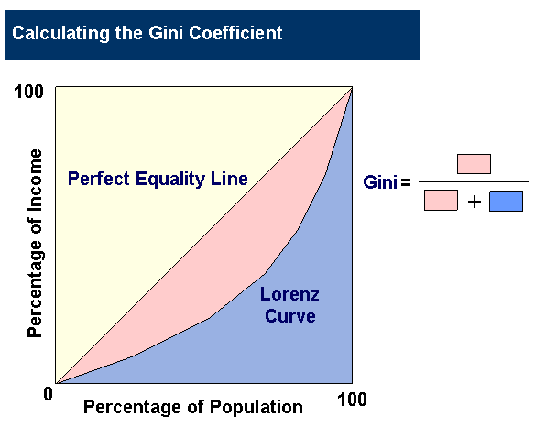
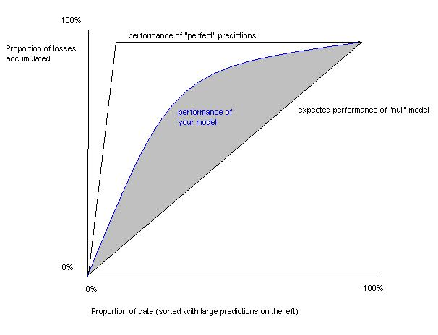
Model/contest evaluation
On a normalized Gini coefficient
The goal is essentially to build a model which predicts the correct order in terms of hazard.
The Gini Coefficient measures the area between your models Lorenz curve and that of a completely random submission.
The Gini coefficient can be used as a metric for determining how close your submission's order matches the actual one.
Rank ordering is scored, so maybe calibration is not as important?
Notes:
Gini coefficient closely related to the AUC (Area Under receiver operating characteristic Curve) measure of performance.^{[78]} The relation follows the formula
Kind of like AUC only for more than 2 classes
The normalized Gini is obtained by dividing the Gini coefficient of your model by the Gini coefficient of a perfect model.

Slide 11

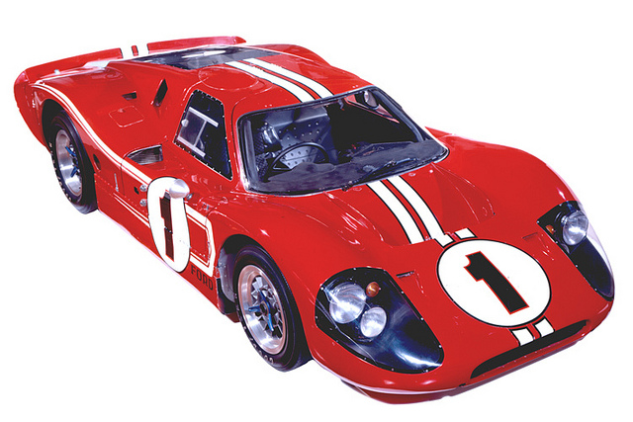
FTW, the
xgboost extreme Gradient Boosting (Tree) library, used by the top competitors on Kaggle
Ugh, have to build it first,
Wasn’t too bad.
51,000 and dummy variables may need extra processing if trying to do LOOCV
Amazon, rent a server?

Slide 12
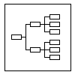
Solution organization
Explore.py
Preprocess.py
Model.py
Score.py

